Slide 1

BlueWARRIOR Cybersecurity Introduction
Information & Physical Security Awareness
BlueKey™ Traffic Cabinet Lock & Padlocks

Slide 2

The Use of the #2 Key is Over
Presented by
BlueWARRIOR
CYBER-SECURE
Locking Division

Slide 3
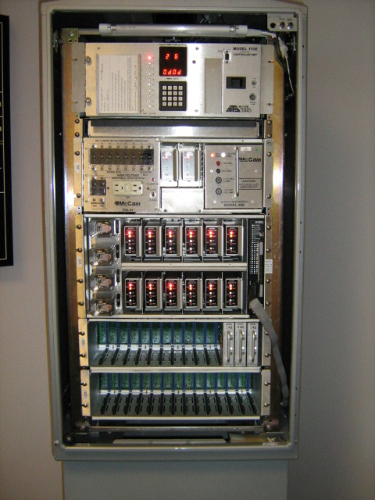
CONTENTS
Defining the Problem
Cyber Threat Solution
BlueTooth Versions
Multi-Function Lock
What Do We Secure
Use Areas for BlueKey™
Conclusion.

Slide 4
Defining the Problem
There is a lot of infrastructure here in the US – located in public places – secured with a #2 Key
The #2 Key is used in all 50 States and in the US Territories
Most departments have no idea how many keys have been issued, lost, who uses them or when?

Slide 5
Defining the Problem
There is little to no control of contractors or their employees with access to cabinets.
You can buy a #2 Key on Ebay for $5.00
The use of these keys provides no Auditable Trail of who accessed the equipment and exactly when it was accessed. No departmental control.

Slide 6
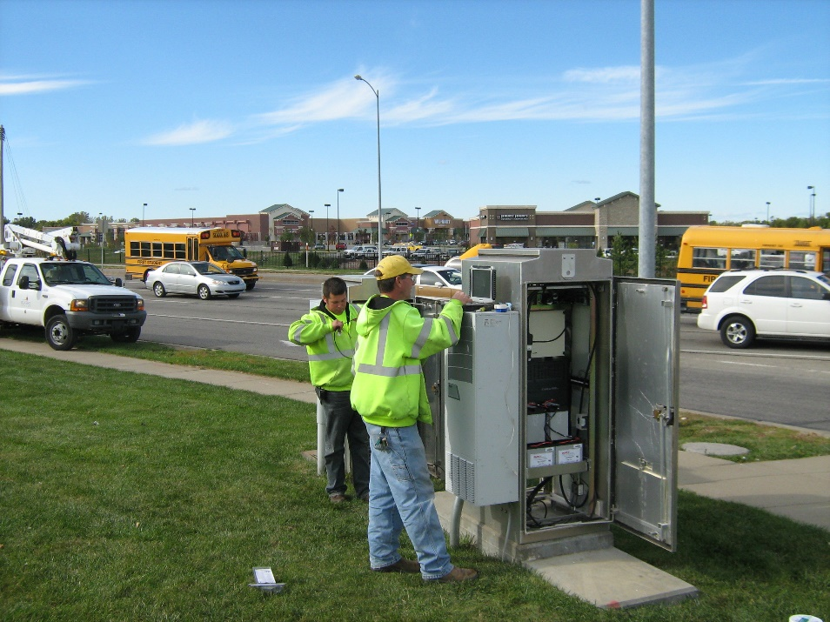
Defining the Problem
Do you know who has access to your cabinets?
  Fire?
  Police?
  Emergency Services?
  Traffic Personnel?
  ITS?
  Contractors?

Slide 7
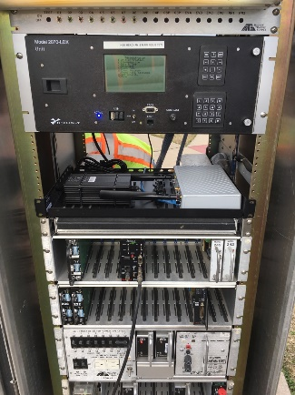
Defining the Problem
Did you Know:
Do you know the value of your cabinets?
  If you’re talking about the costs the government has to pay, the costs can range anywhere from as little as $80,000 to more than $500,000 to purchase and install the traffic lights. When you add in the routine maintenance and electric bills, this can be an additional $5,000 to $10,000 a year.
  According to the Arizona Department of Transportation, a modern traffic signal can cost $80,000 to $100,000 to install, depending on the complexity of the location and the characteristics of the traffic in the area.

Slide 8
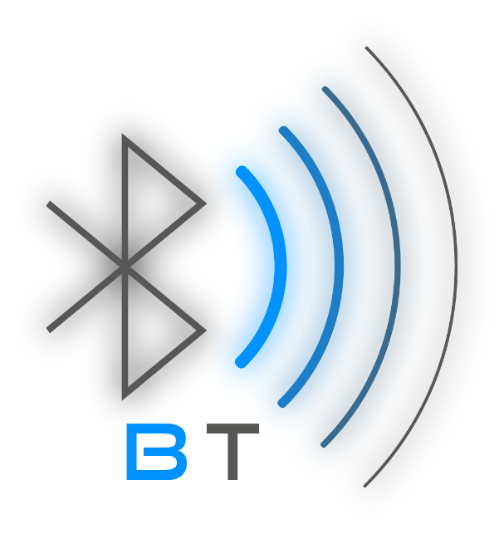
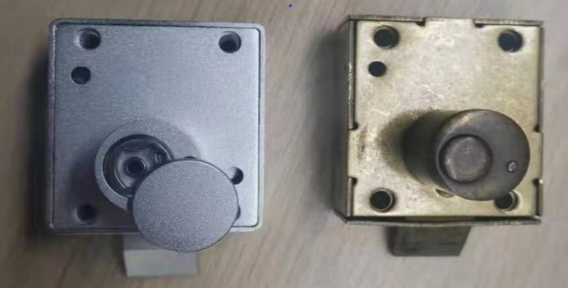
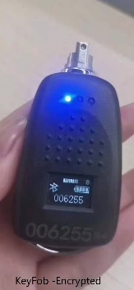

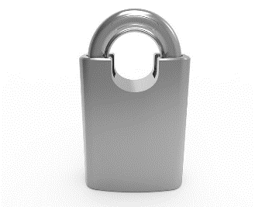
CYBER THREAT SOLUTION
BlueWARRIOR
BlueKey™ Smart Cabinet Lock & Padlocks

Slide 9

CYBER THREAT SOLUTION
BlueWARRIOR
BlueKey™ Smart Cabinet Lock & Padlocks

Slide 10
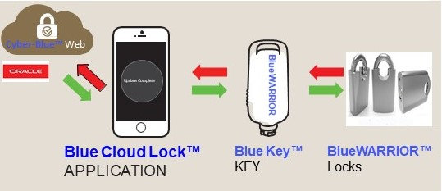
4 Components to the BlueWARRIOR Solution
BlueWARRIOR BlueKey™
Encrypted Smart Cabinet Lock & Padlocks

Slide 11
1st Component to the BlueWARRIOR Solution
Cyber-Blue – World Wide Web Database
Secure, Encrypted – Hosted by Oracle

Slide 12
2nd Component to the BlueWARRIOR Solution
Blue Cloud Lock – FREE Android Mobile App
Secure, Encrypted – Updates Anywhere

Slide 13
3rd Component to the BlueWARRIOR Solution
BlueKey™–Secure, Encrypted – Updates Anywhere, Anytime - Rechargeable

Slide 14
4th Component to the BlueWARRIOR Solution
BlueWarrior™– Locks – Traffic Enclosure or Padlocks - Secure, Encrypted & Pickproof

Slide 15

DYMEC Smart Bluetooth Traffic Cabinet Enclosure Lock
The DYMEC Smart Bluetooth Cabinet Lock (BCL) is a smart encrypted cabinet lock integrated with BLE Bluetooth. The systems provides a fully auditable record of who and when entry to a specific cabinet occurred. Cabinets can be unlocked and managed by users through a mobile phone application and via the directly connected background management system via the web.

Slide 16
Multiple Function Lock
The Cabinet Smart lock has multiple functions such as:
Mobile Phone Key Updates
Centralized Permission Management
Record query
Encryption
Lock status detection
Network Synchronized Time Stamps
Emergency Key Back up
Customized Bluetooth Dongle
Complete Access Audit Trail

Slide 17
What Do We Secure?
Users can efficiently, securely, and safely manage various cabinet doors through the mobile phone application and centralized background management system. Typical application scenarios are:
Traffic Cabinets
Power Distribution Cabinets
Communication Cabinets
Server Cabinets
Construction Trailers
Supply & Material Lockers
Area Access Gates & Doors
Or any Asset requiring Auditable Access

Slide 18

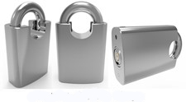
Use Areas for
BlueKey™ Smart Locks
Traffic Cabinets:
Ancillary Equipment Cabinets:
Telecommunications Equipment Cabinets:
Water System Facilities:
Sewage System Facilities:
Storage – Equipment & Material Facilities:
Building Access
Vehicle Access Sites

Slide 19
Use Areas for
BlueKey™ Smart Locks
Traffic Cabinets:
Ancillary Equipment Cabinets:
Telecommunications Equipment Cabinets:
Police – Public Safety Facilities
Water System Facilities:
Pool Facilities:
Gym & Recreation Facilities
Sewage System Facilities:
Storage – Equipment & Material Facilities:
Building Access
Vehicle Access Sites

Slide 20
Use Areas for
BlueKey™ Smart Locks
Information Technology:
Airports:
Power Generation Facilities:
Power Distribution Facilities:
Banking Facilities:
Commercial Facilities:
Data Centers:
School & Educational Sites:
Healthcare:

Slide 21
Use Areas for
BlueKey™ Smart Locks
Public Arenas & Stadiums:
Vending Machines:
ATM’s:
Casinos:
Church Facilities:
Toll Facilities:
Transmission Centers:
Nursing Homes:

Slide 22

Advantage BlueKey™
BlueWARRIOR BlueKey™ Smart Traffic Enclosure Lock
Low Cost – Full Audit Trail

Slide 23
Advantage BlueKey™
BlueWARRIOR BlueKey™ Smart Traffic Enclosure Lock
No Batteries – No Wiring – No Maintenance

Slide 24
Advantage BlueKey™
BlueWARRIOR BlueKey™ Smart Traffic
Enclosure Lock
Exact Duplicate Enclosure Lock – Easy Installation

Slide 25
Advantage BlueKey™
BlueWARRIOR BlueKey™ Smart Traffic Enclosure Lock
Every Lock has its own Unique Encrypted ID

Slide 26


Advantage BlueKey™
BlueWARRIOR BlueKey™ Encrypted – USB Rechargeable Bluetooth Key – Stainless Steel

Slide 27
BlueKey™ Smart Locks
Advantages
Custom Encryption Chipset for High Security
  Secure Encryption Algorithm Chip
  Near Field Connection (NFC)
  RFID
  Key & Lock Fully Encrypted
  No information Transmitted in the Clear

Slide 28
BlueKey™ Smart Locks
Advantages
Full Audit Trail of Entry
  Meets or Exceeds IP65
  Maintenance Free
  Pick proof Lock
  Time Stamped Records
  NIST Security Standards

Slide 29
BlueKey™ Smart Locks
Advantages
NIST Compliant
  Encrypted & Cyber Secure
    Precision Time Stamped Records
    Stores >20,000 Cylinders
    Stores >60,000 Audit Events

Slide 30
BlueKey™ Smart Locks
Advantages
No Maintenance Required
  No Batteries in Locks
  No Wiring / Easy Installation
  Rechargeable USB Key Fob
  Smart Chip Encryption
  LED Indicator Lights
  LED Readout Screen
  Each Key Fob has a unique encrypted ID

Slide 31
BlueKey™ Smart Locks
Advantages
Secure Database Hosted by Oracle
  Cyber Secure
  Every Customer has their own secure database
  Yearly Subscription
  Full Audit Trail of All Keys & Locks
  Update Keys via Mobil phone
  Accessible from anywhere - anytime
  Precision Timestamped and dated records

Slide 32
BlueKey™ Smart Locks
Advantages
Low Cost
  Our Lock is cheaper than 1 Radio Key
  Unable to be duplicated
  Built-in Encryption
  Easy to Use & Manage

Slide 33
BlueKey™ Smart Locks
Advantages
Custom Keys Available
  FREE Cell Phone Application – BlueCloudLock
  ORACLE Cloud Security – Cyber-Blue
  Low Cost

Slide 34

  Email: Sales@BlueWARRIOR.com
  Phone: (816)-214-1946
/
Questions?

Slide 35

Thank you from
BlueWARRIOR !

